Slide 1
GEOPOLITICS OF THE WORLD ECONOMY
The US and China in Context
World-City System and the World Economy

Slide 2
Overview
1. Putting the present in the context of different geopolitical eras
2. Post-1990: three main stories
A. US decline
B. Rise of China
C. States versus global city-regions

Slide 3
A: The US and China in Context FOUR MODERN GEOPOLITICAL ERAS
Concert of Europe/Colonialism (1815-1875)
Inter-Imperial Rivalry (1875-1945)
Cold War (1945-1990)
Post-1990: “Market Access” and Networked Power. (As we know from previous classes this era is very different from the past ones (global supply chains, etc.))
(a) US Decline?
(b) Rise of China?
(c) States and City-Networks? (next lecture)

Slide 4
Background to the first two stories:
GDP versus GDP per capita (Figures 1 and 2)
The popularity of a “Slipping US” and a “Rising China” (Figure 3)

Slide 5
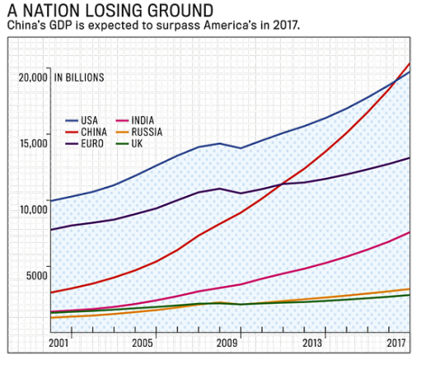
Figure 1: US versus China: A Popular but Misleading Story

Slide 6
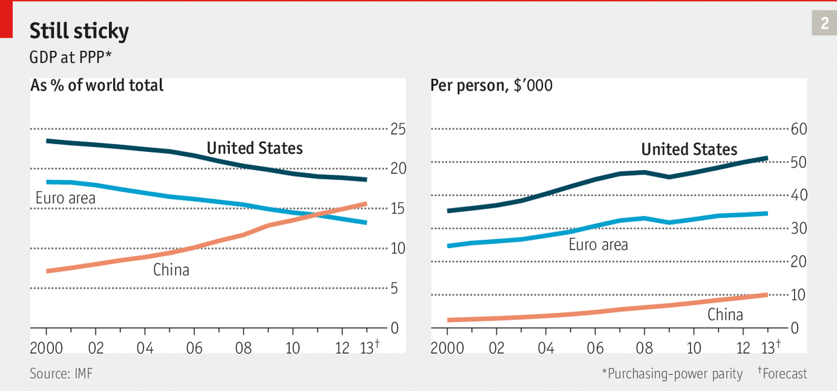
Figure 2: GDP versus GDP per capita

Slide 7
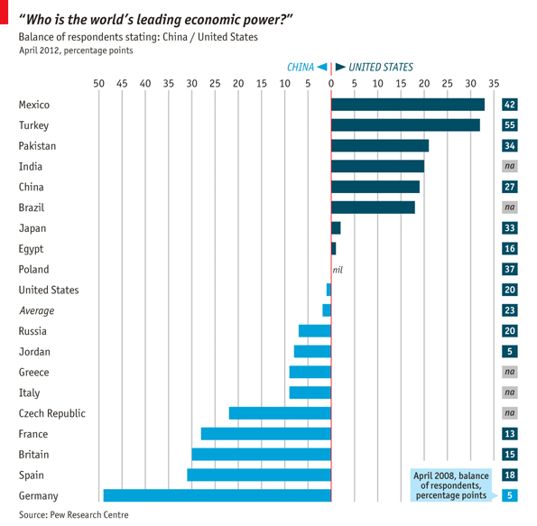
Figure 3: “Top Dog” in Popular Consciousness

Slide 8
Pros to the Rise of China
Pros: manufacturing heft (but will change, as we know) (Figure 4); trading partners (Figures 5 and 6); weight in world GDP and foreign-exchange reserves (Figures 6&7); not just China but a drift eastwards in world GDP (Figure 8); sovereign wealth funds (Figure 9); IPOs (Figure 10); world banking rankings (Figure 11); innovation and post fossil fuels economy (Figures 12a and b); China as an investment source (Figure 13); political reassertion (Figure 14); US fears (Figure 15).

Slide 9
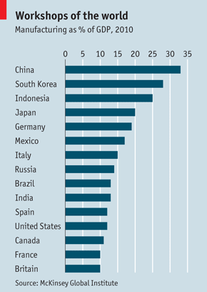
Figure 4: Manufacturing Heft

Slide 10
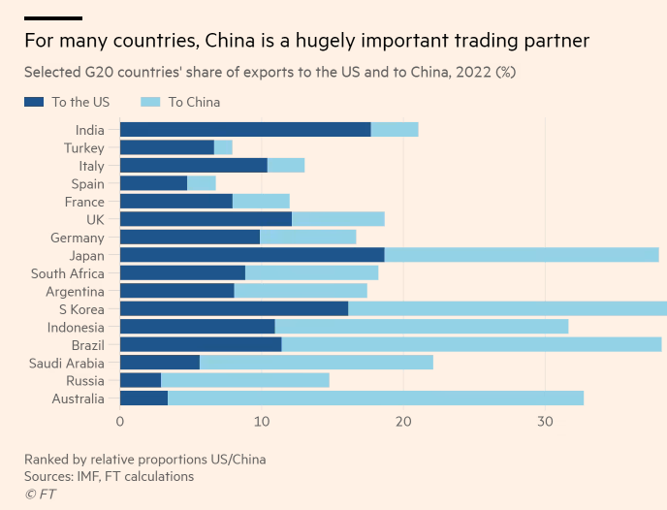
Figure 5a China’s Trading Partners versus those of the USA

Slide 11
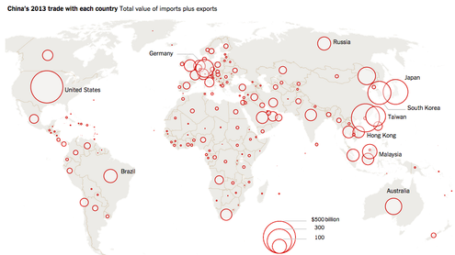
Figure 5b: China’s Trading Partners

Slide 12
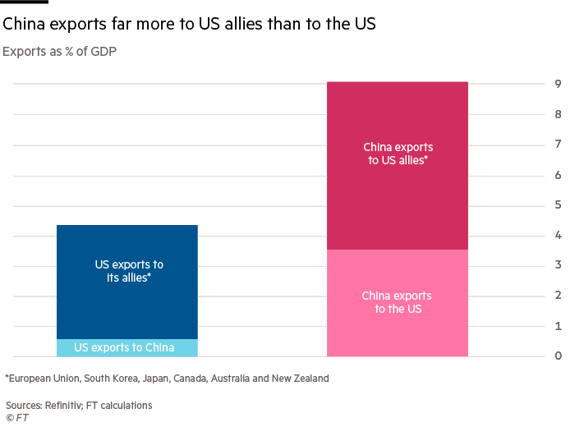
Figure 6: China’s Export Leverage

Slide 13
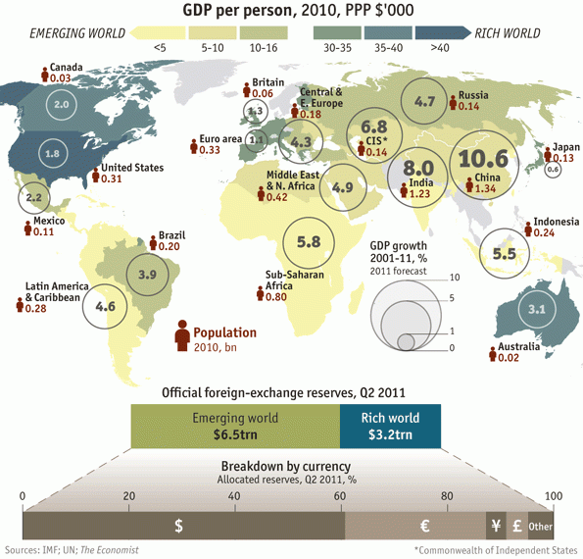
Figure 7: China’s weight in GDP Growth and Foreign-Exchange Reserves

Slide 14
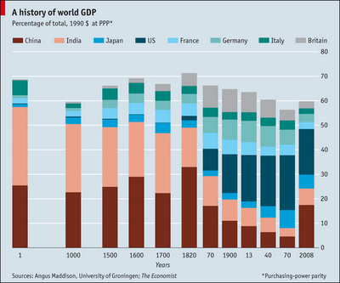
Figure 8: The World Economy’s Center of Gravity is Moving Back East

Slide 15
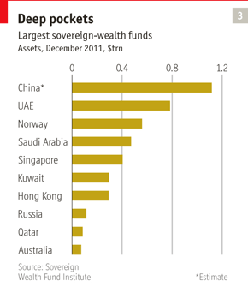
Figure 9: Sovereign Wealth Funds

Slide 16
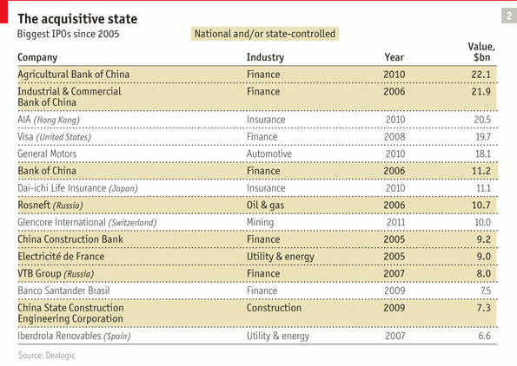
Figure 10: Biggest IPOs

Slide 17
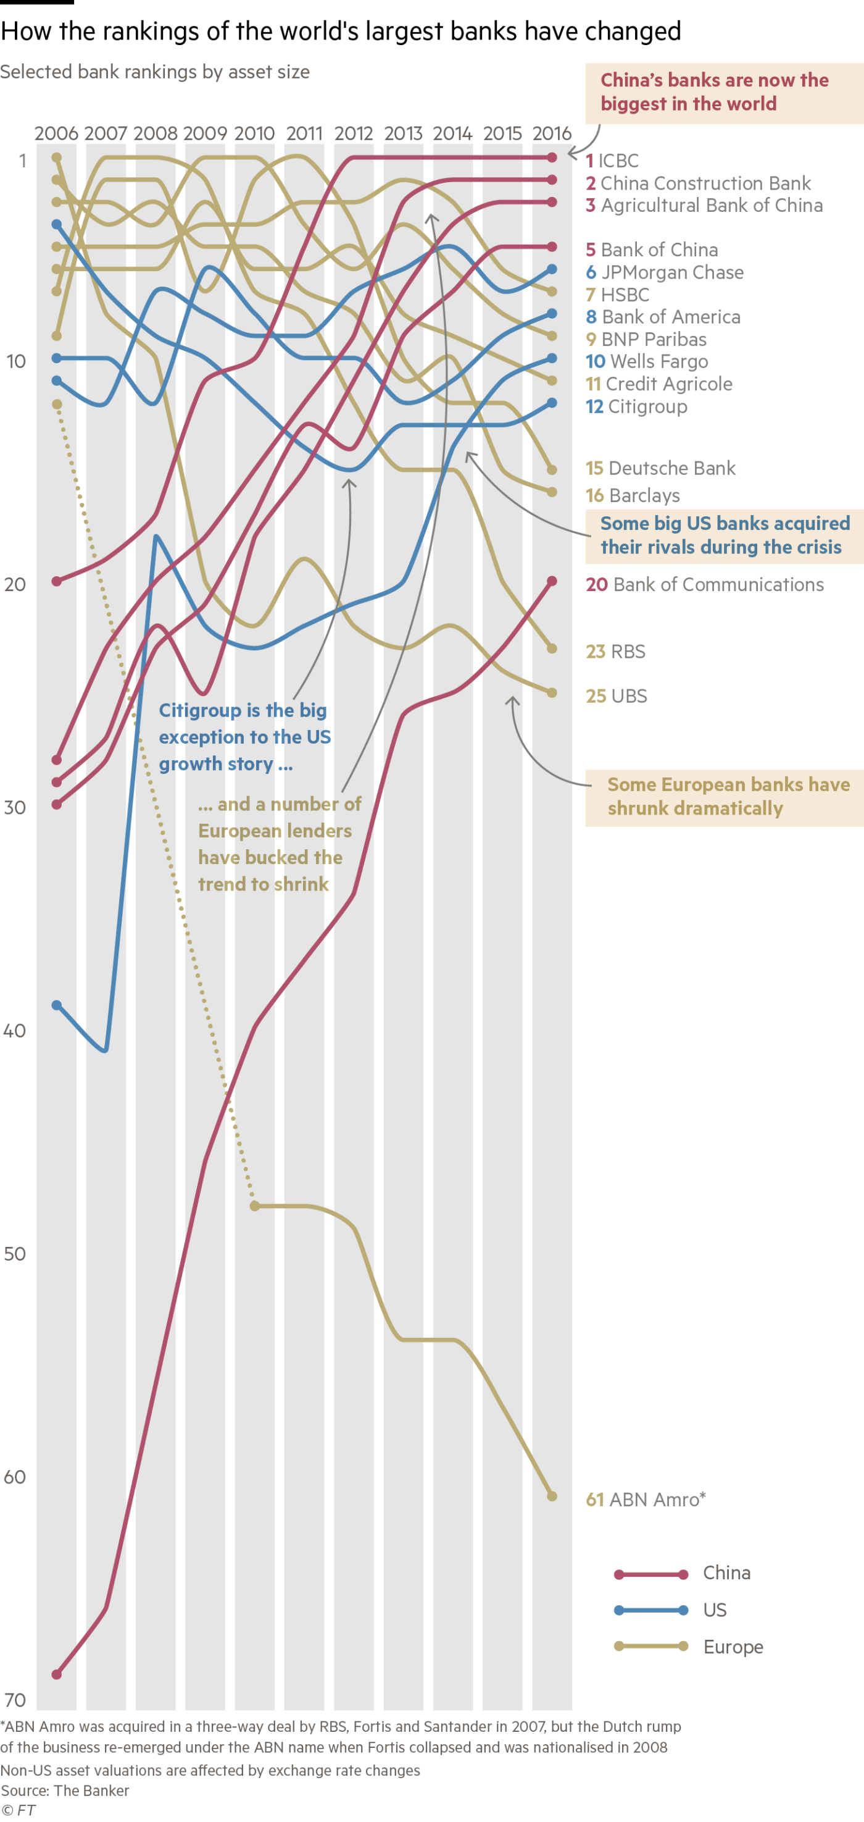
Figure 11: World Banking Rankings, 2006-16

Slide 18
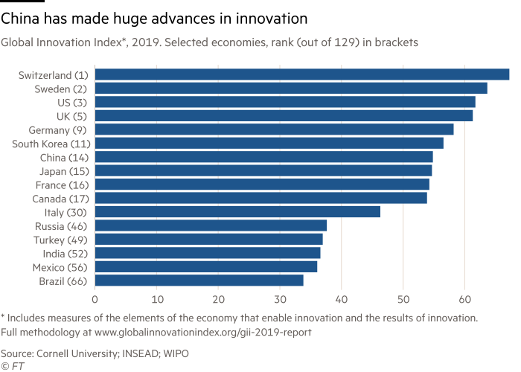
Figure 12a: Innovation

Slide 19
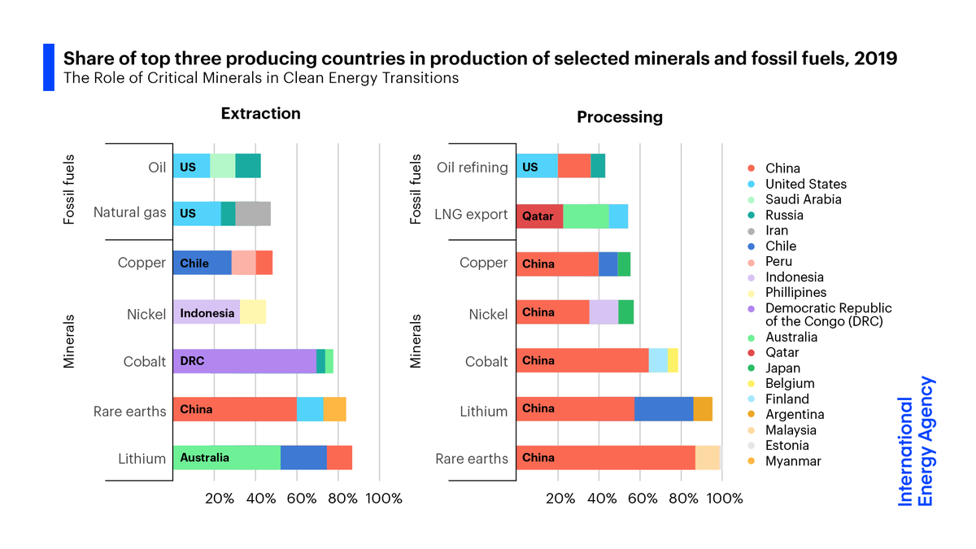
Figure 12b: From fossil fuels to minerals (for solar panels and batteries)

Slide 20
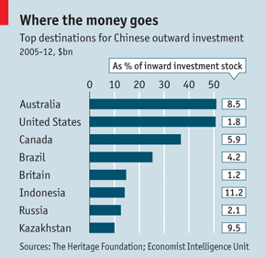
Figure 13: China as an Investment Source

Slide 21
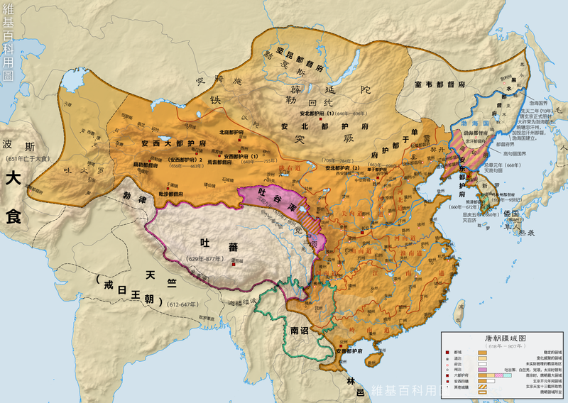
Figure 14: Looking Back to Look Forward?

Slide 22
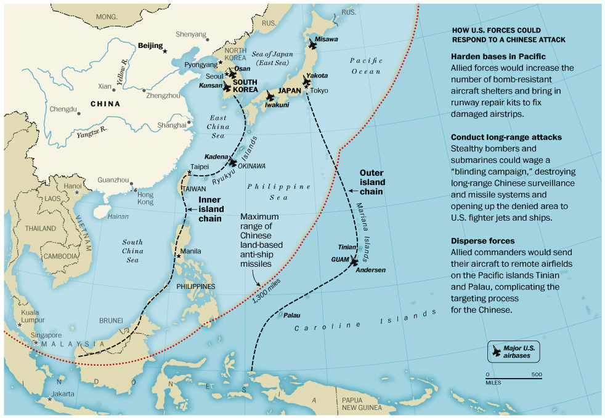
Figure 15: Is US Security Policy Following?

Slide 23
Cons to the Rise of China/Decline of the US
Cons: biggest companies are still mainly US-based (but with large foreign assets) and US shares of world trade, GDP, and role of US$ still strong (Figure 16); China has a large but ageing population (Figure 17); Do graphs always just go up? (Figure 18); China will not reach 60% US per capita GDP at current rate until 2060 (Figure 19); debt finance is a heavy drag on China’s businesses (Figure 20); China lags US in IT (Figure 21); China may overtake the US as world’s biggest economy by 2033 but only if growth does not slump below 7% GDP per year (Figure 22).

Slide 24
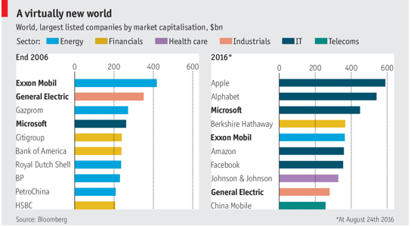
Figure 16a: Biggest Companies and their Global Reach

Slide 25
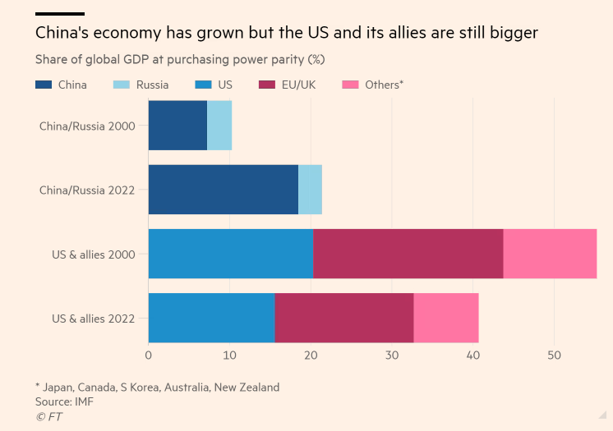
Figure 16b: If there be blocs, then

Slide 26
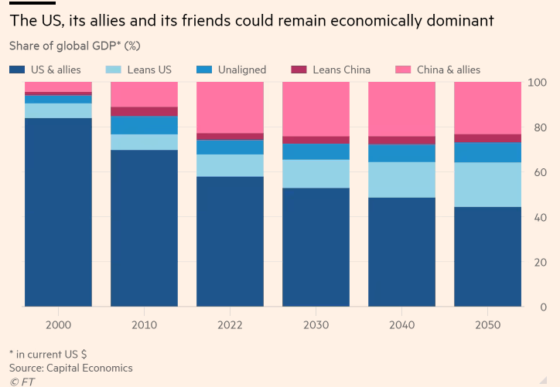
Figure 16c: Shares of Global GDP

Slide 27
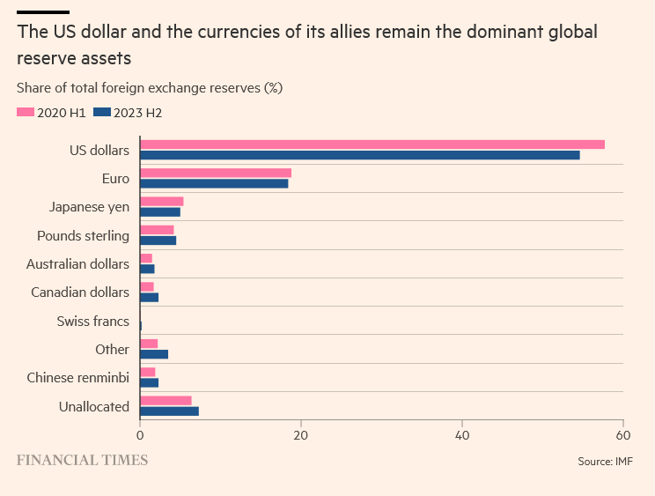
Figure 16d: The US$ Still Rules

Slide 28
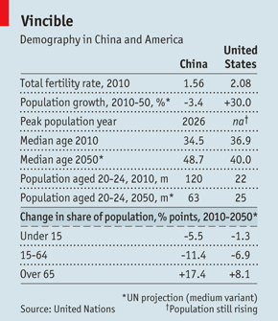
Figure 17: Demography and Ageing

Slide 29
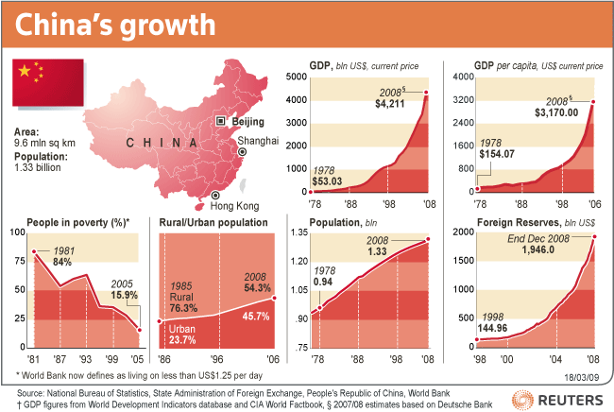
Figure 18: Can Growth Go on Forever or Regression to the Mean?

Slide 30
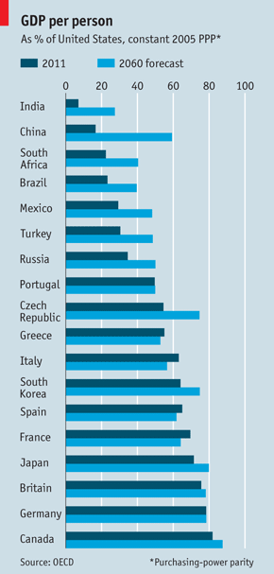
Figure 19: When Will China Reach 60% of US GDP per capita?

Slide 31
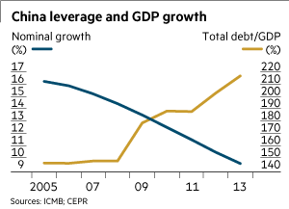
Figure 20: China’s Debt Load

Slide 32
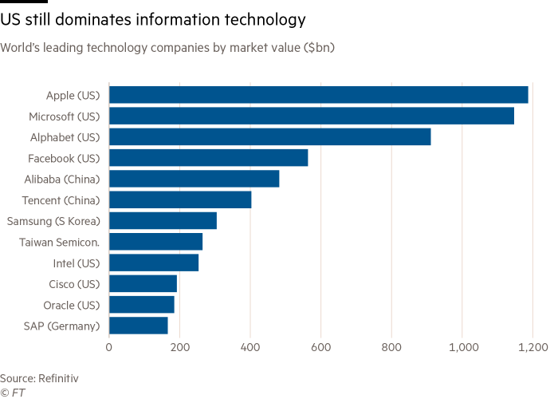
Figure 21: The US and IT

Slide 33
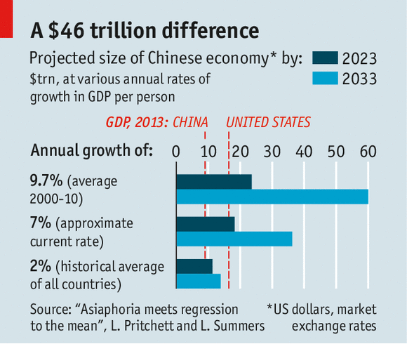
Figure 22: What Does the Future Hold for Economic Growth in the US and China?

Slide 34
Is the Comparison Useful These Days?
Decoupling and protectionism (Figure 23)
Has US business given up on globalization? (Figure 24)
Has the world given up on the US? (Figure 25)
Is the US overstretched militarily for no good purpose? (Figures 26&27).
China is becoming more invested in the world economy? (Figures 28&29)

Slide 35
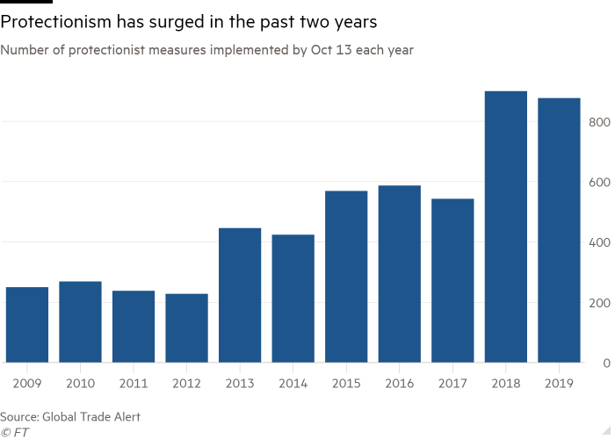
Figure 23: Protectionism and Decoupling?

Slide 36
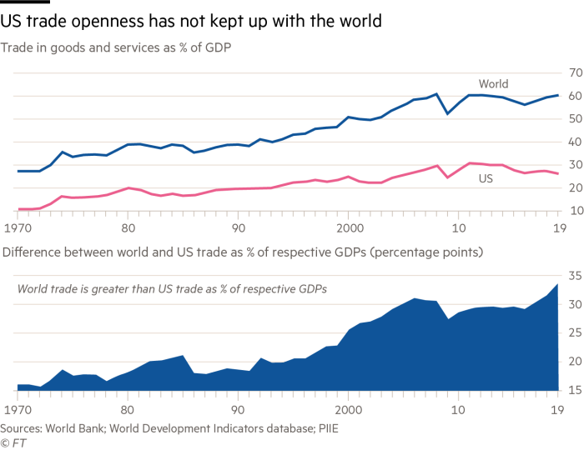
Figure 24: Has US Business Given Up on Globalization?

Slide 37
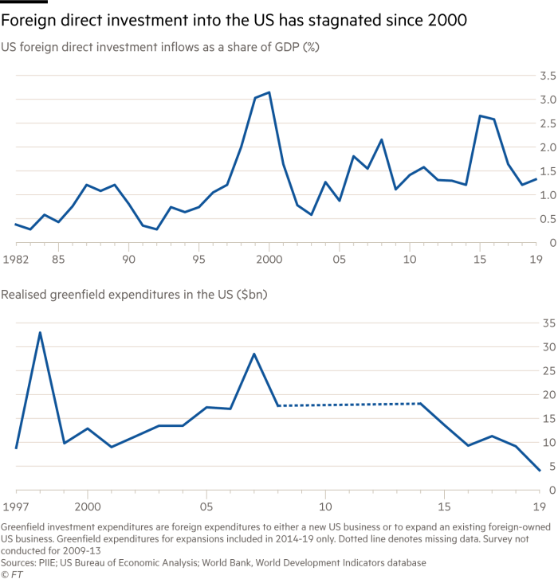
Figure 25: Has the World Given Up on the US?

Slide 38
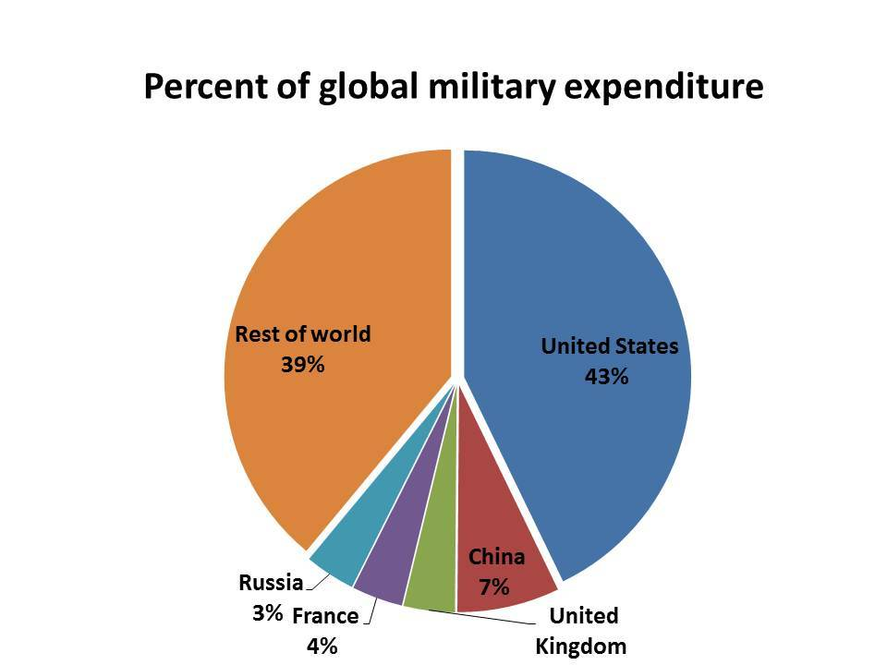
Figure 26: Imperial Overstretch for the US?

Slide 39
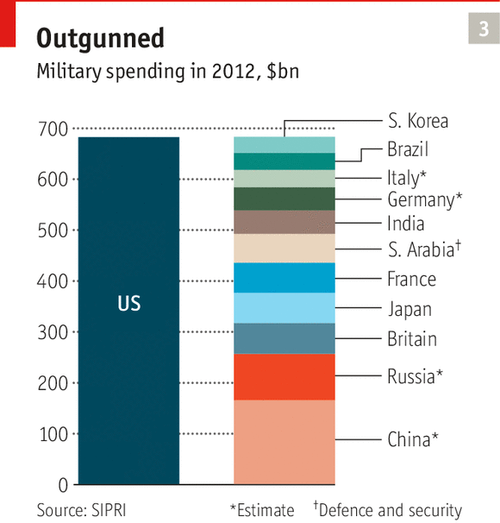
Figure 27: Money Well Spent?

Slide 40
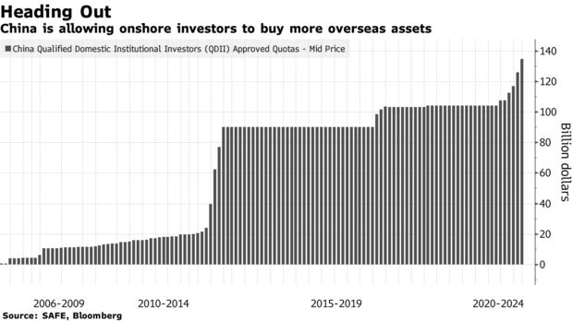
Figure 28: China Goes Outwards?

Slide 41
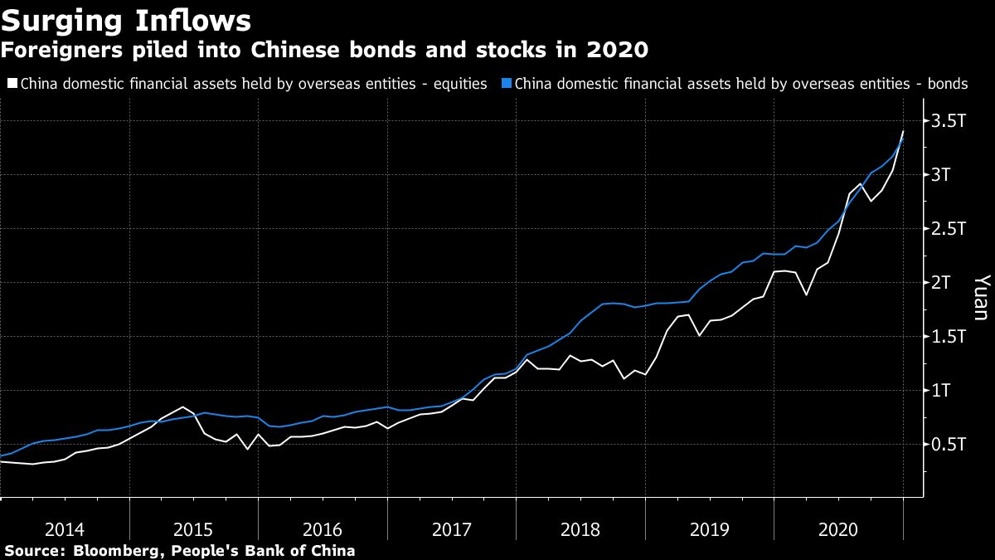
Figure 29: Foreigners Invest in China

Slide 42
Conclusion
The China-US competition is overwrought: each depends on an interdependent world economy.
But the US, “home” to contemporary globalization, seems in more of a retreat, perhaps mistaking “China” as an adversary when it is more its own businesses who are behind its travails?
Perhaps this whole framing is problematic on its own. What if the world-city system is now also part of the global economic equation and not simply dependent on states?

Slide 43
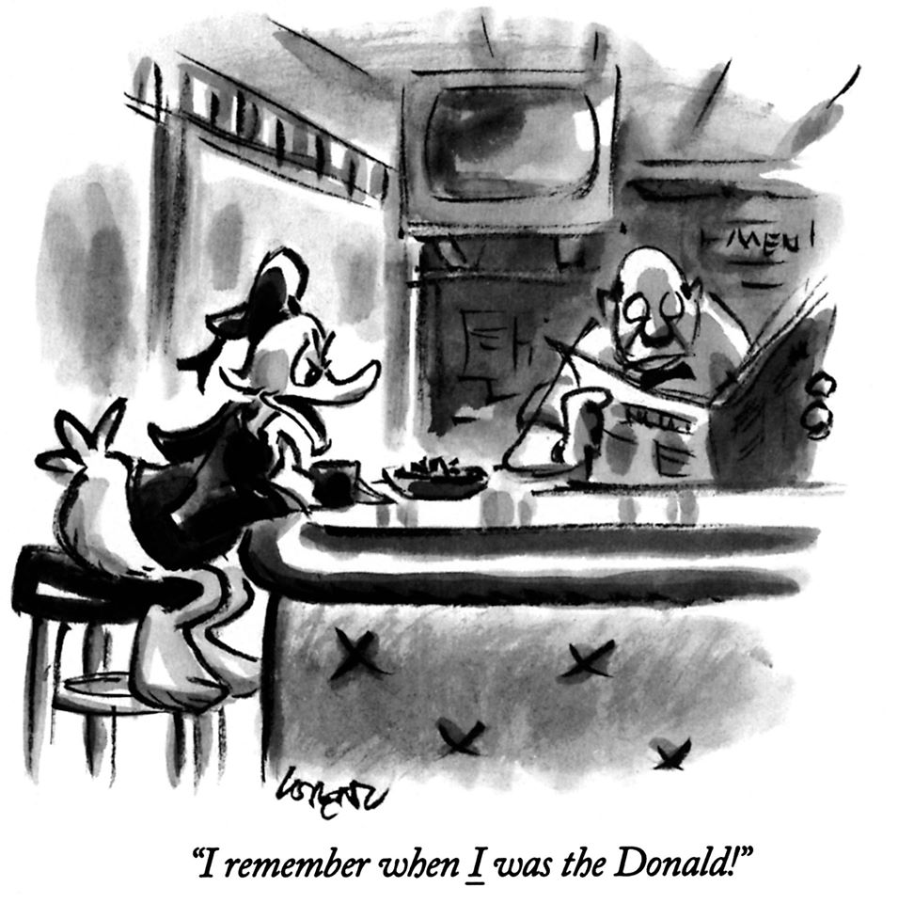

Slide 44
B: World-City System and the World Economy
1. Transport costs versus agglomeration economies (Figure 1)
2. Cities as growth nodes (East Asia and southern hemisphere cities). The world is less Europe/North America centered today and organized around city-hinterland connections and intercity networks (Figures 2&3)
3. The privatization of political authority (credit rating as an example) and low tax jurisdictions (Figures 5&6, 7)
4. Megacities and an evolving city-system (Figure 8)
5. Not all cities have agglomeration economies (Figure 9)
6. The technological limits to economic growth (Figures 10-12)
7. Transport costs going up? (Figures 13-14)

Slide 45
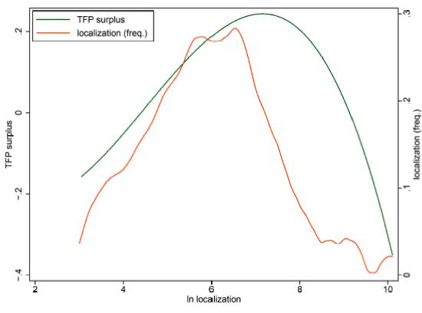
Figure 1: The Returns to Firms by being Located Close to Other Firms in the Same Sector

Slide 46
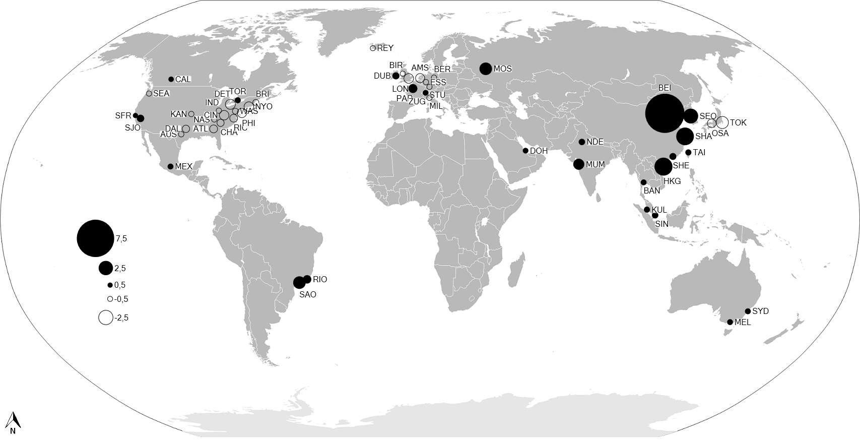
Figure 2: Shift in Top Financial Sector HQ Operations (2007-2011)

Slide 47
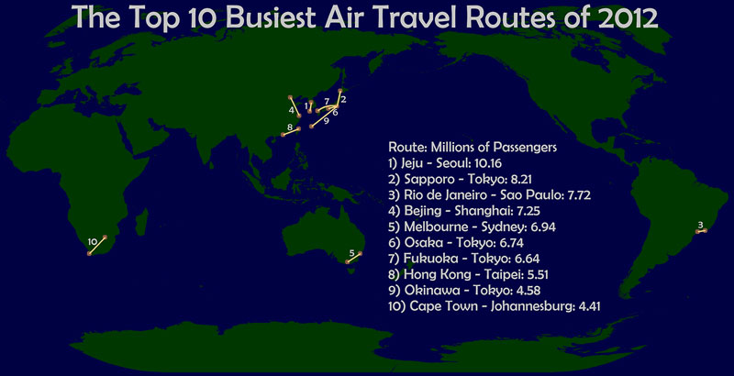
Figure 3: Surprising Air Traffic Routes

Slide 48
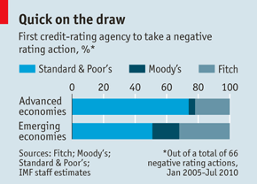
Figure 5: Credit raters, business and governments

Slide 49
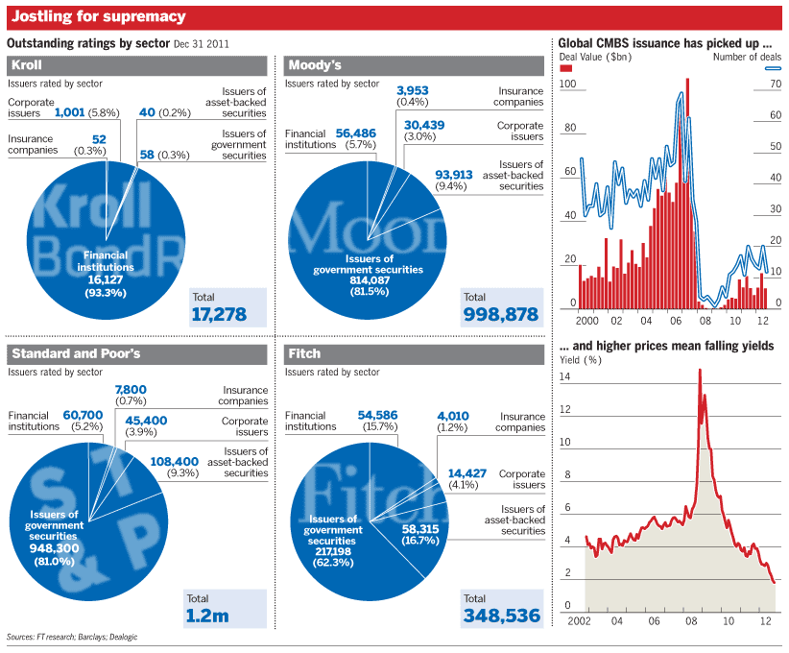
Figure 6: Credit Rating for Businesses and Governments

Slide 50
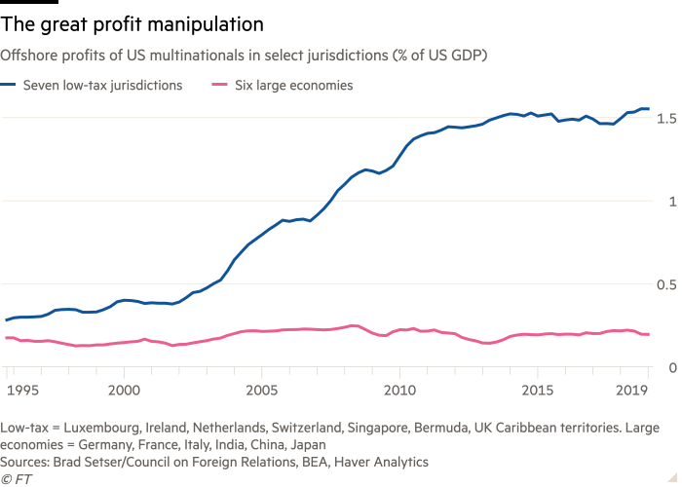
Figure 7: Fiscal Havens in Low Tax Cities/Jurisdictions

Slide 51
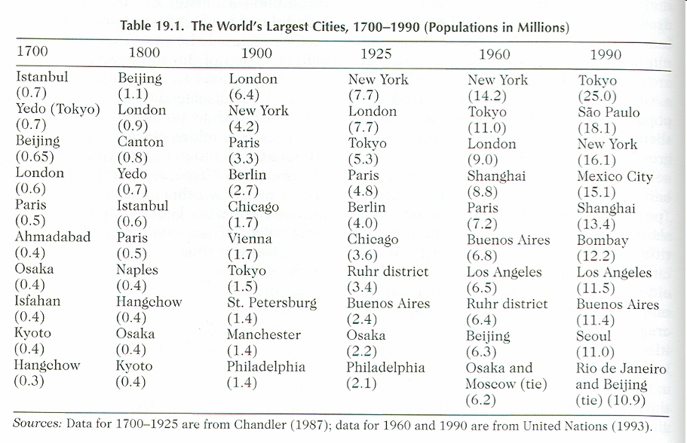
Figure 8: The World’s Biggest Cities

Slide 52
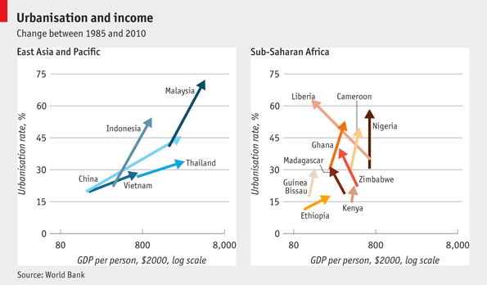
Figure 9: Urbanization and Income Growth

Slide 53
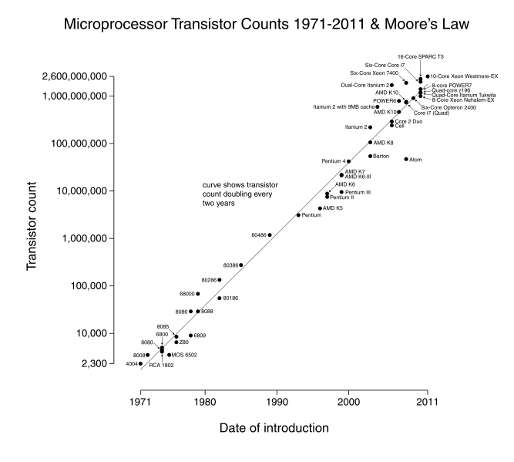
Figure 10: The Big Enabler

Slide 54
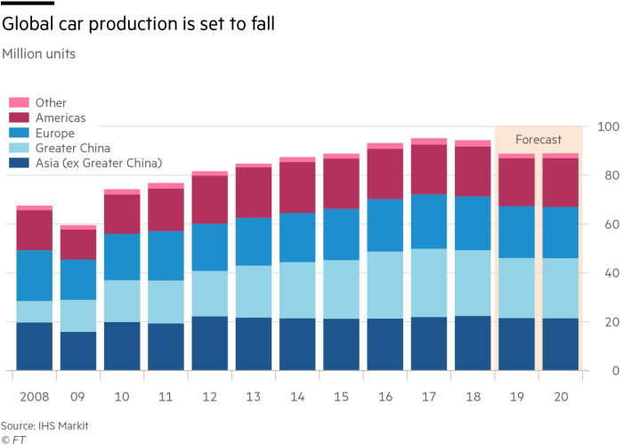
Figure 11: Don’t Bet on Old Sectors

Slide 55
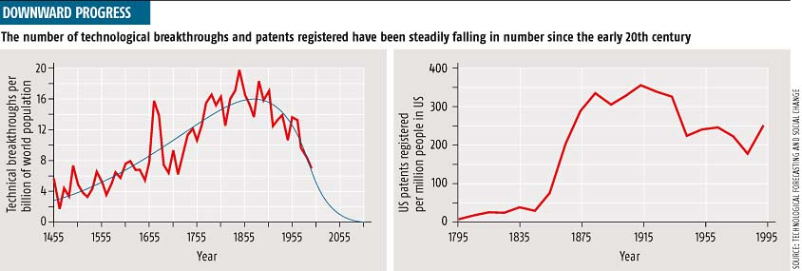
Figure 12: The Limits to Growth? Have we picked all of the fruit?

Slide 56
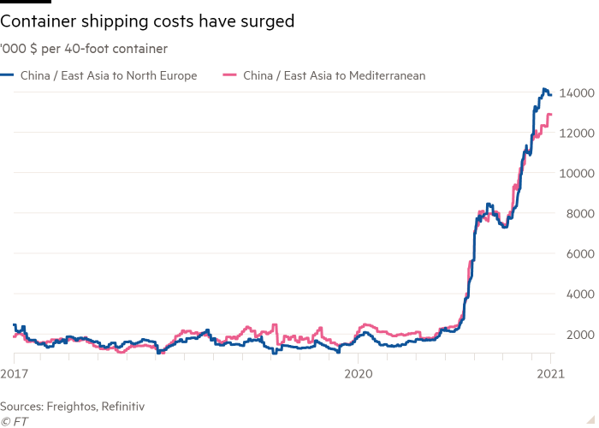
Figure 13: Transport Costs Make a Comeback?

Slide 57
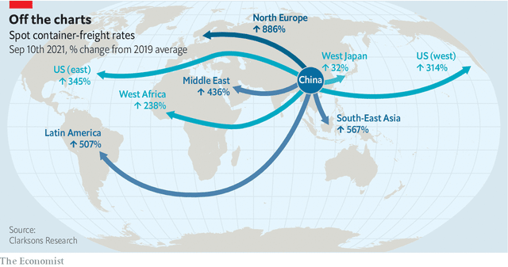
Figure 14: Limits to Moving Stuff Worldwide?

Slide 58
Conclusions
In a world where agglomeration economies are so powerful cities rule.
Cities are the dominant nodes of growth today even more than in the past.
But not all urbanization is productive in terms of growth and better incomes.
Are we coming up against the limits to growth in terms of both technologies and sustainability? This will be the biggest challenge to globalization as we experience it today.

